Slide 1
ICT502-INTERNET AND WEB DEVLOPMENT
JOB RECRUITMENT PLATFORM
STUDENT NAME:RAHUL TUNDIYA
STUDENT ID: S20241757

Slide 2
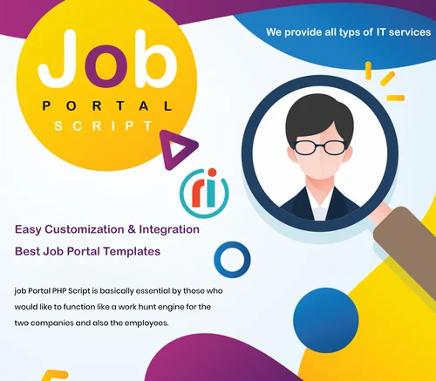
Notes:
Welcome to the Recruitment Job Portal, a one-stop-shop for all your job search and recruitment needs. Both end users and administrators will find this web application useful because it is a complete system for controlling job applications.

Slide 3

So, as an admin, you can manage all the jobs. You can add, update and delete posted jobs. All the required skills need to be specified in the description section.
And if you received enough submission on any application, you could simply disable that job or vacancy. And the future submission on that application will be disabled. As an admin you can manage all the applications received.
Notes:
As a user or job seeker it can help in many ways, now you don’t need to go to companies. They will come to you. You just need to filter the jobs according to your skills. And that’s it, you just need to fill in your personal details and all the skills related to your jobs. And you also have the option to upload your CV and the Resume.

Slide 4


The development of this platform is based on PHP. Where HTML, CSS and jQuery are used to enhance user experience.
Also, it has responsiveness to fit the application to every size of screen and devices. And used MySQL to handle data in application.
Notes:
And it makes it easy for them to find a perfectly fitting employee. They can filter between all the applications and manage their posting on the admin panel. The platform is divided into two portions. On is user and the second is admin. And the third is staff. But the staff role depends on admin.

Slide 5
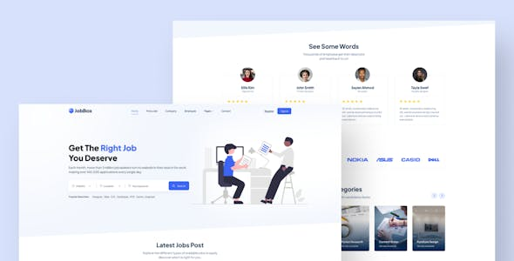
Notes:
We also ensure that all the features are up to date and working fine. To give smoother experience to user and admin. The application went through Unit testing and many more types of testing to make it bug free. And optimized to make future updates more smoothly. And there are so many functionalities and features in this application. For that you need to Go through the JOB RECRUITMENT PLATFORM. Thanks for choosing this platform. Surely this will help many jobs seeker and employers in future.

